Slide 1
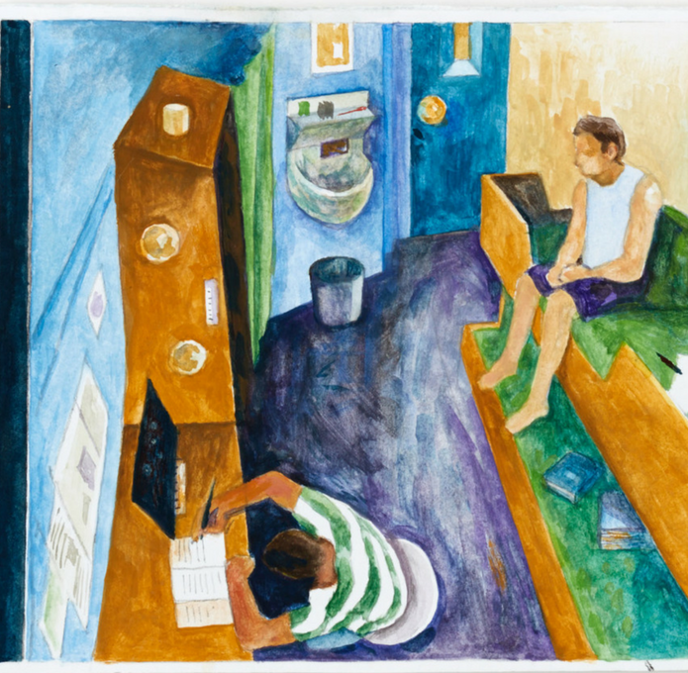
Keeping Safe Under COVID
Plenary:
Juliet Lyon CBE
Chair, Independent Advisory Panel on Deaths in Custody

Slide 2
The Independent Advisory Panel (IAP) are an arms-length body, that provides independent advice and expertise to Ministers, senior officials and the Ministerial Board on Deaths in Custody. It assists Ministers to meet their human rights obligations to protect life. The IAP’s aim is to bring about a continuing and sustained reduction in the number and rate of deaths in all forms of state custody in England and Wales

Slide 3
In line with our guiding principle to consult people in custody and their families wherever possible, the IAP has worked with National Prison Radio (NPR) to conduct a rapid review of prisoners’ experience under Covid-19. During these unprecedented times, and when independent monitoring is much reduced, it was – and continues to be – more important than ever to hear about, and to learn from, the experiences of people in custody.

Slide 5
Through a partnership with National Prison Radio, we reviewed 223 phone messages, recorded and received between 18 March and 5 May 2020.

Slide 6
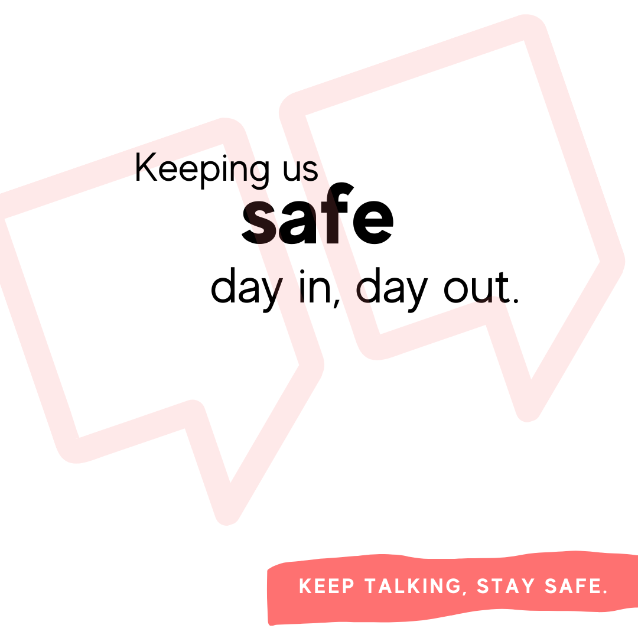
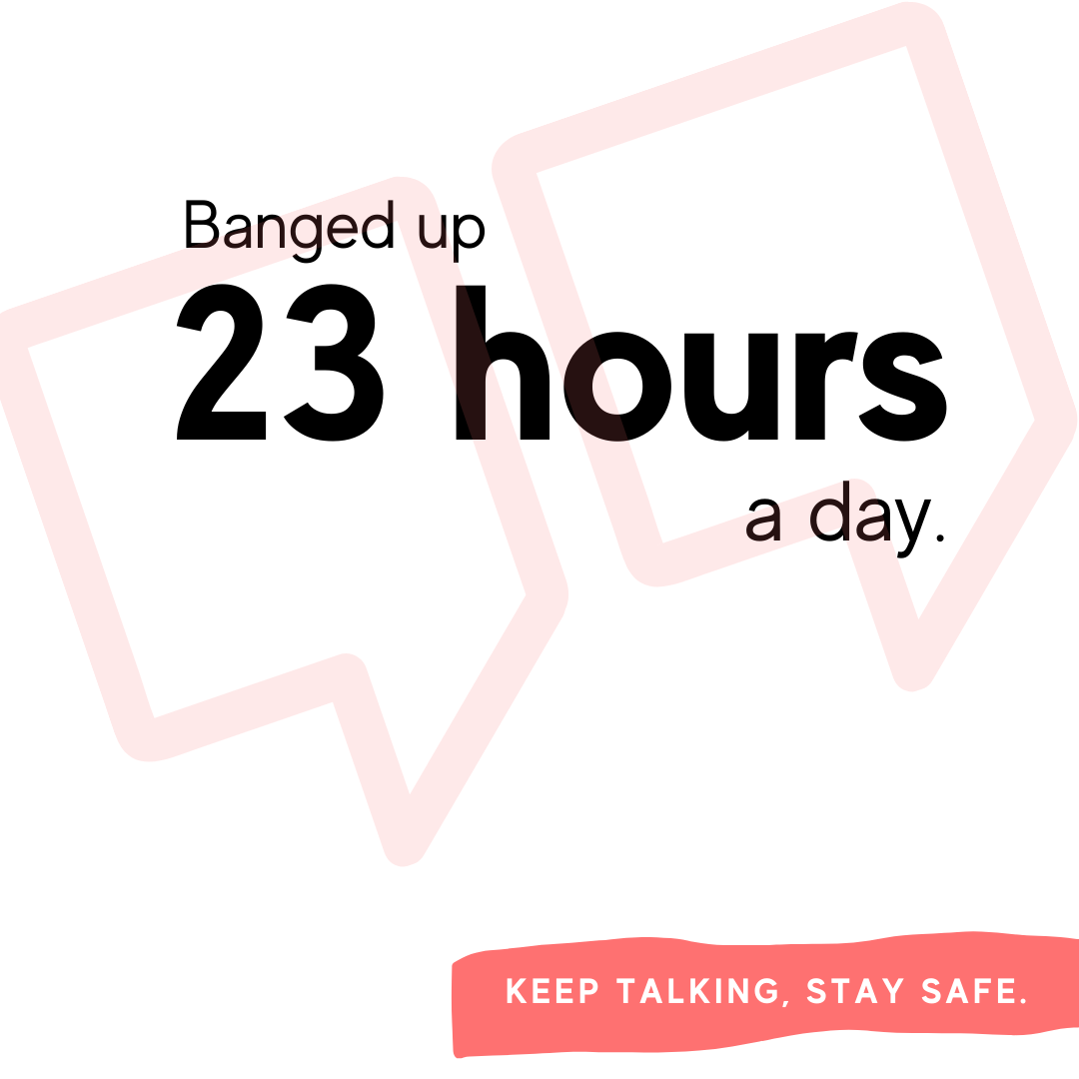
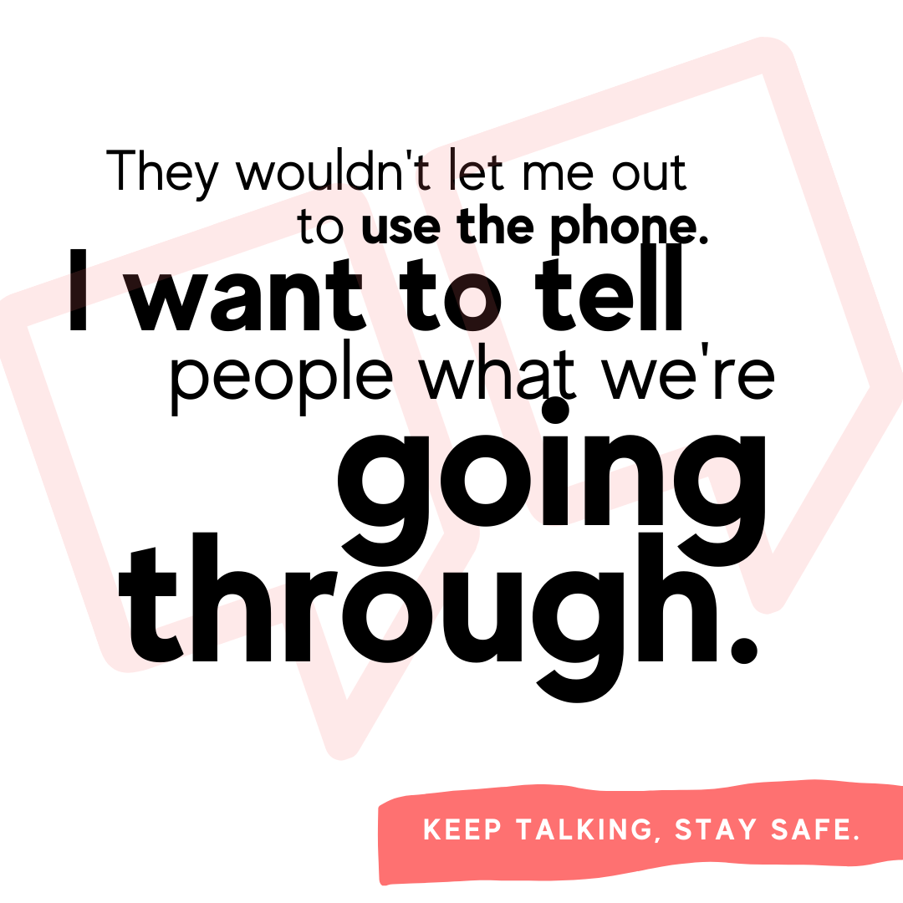

Slide 7
‘Everyone’s frustrated. We're behind these doors, we don't know what's going on. We've stopped having updates now. I used to get updates every 2 days or so explaining what's going to happen. We're just frustrated because we don't know anything.’

Slide 8
‘…no sign of early release, no staff have any clue if it's even true but it's on the news. Prisoners feel like they're sentenced to [a] death sentence if it spreads and it's on several wings.’

Slide 9
It's mad. It's mad what's going on in the world. They've got families, they're so compassionate to us.’
‘Massive respect for all of them, It takes a strong type of person to do what they're doing.’
People are in isolation but the same staff rotate round the whole prison touching everyone's handles, buzzers, paperwork, door - fast way to kill all the prisoners.’

Slide 10
‘But for these people on D wing the staff are like - they know my heads fallen off so many times. I've tried to kill myself. I've tried to do so many crazy things to myself and I just appreciate the way the staff just keep picking me up. Just keep bringing me back and keeping me focused.’

Slide 11
‘The governor says that we're working as a community, that's not right at all. We're not getting listened to at all. When we try to raise our opinions, the staff aren't listening, they just avoid us or tell us to shut up. When people are needing to see the nurse we're not getting seen to. There's a lot of people in here struggling with their mental health.’

Slide 12
- Ensure that people are given clear, accurate and up to date information in accessible forms that all prisoners understand, and that this is ongoing. - Streamline and expedite the early release scheme to create the headroom needed to take active steps to protect life - Build on the success of the keyworker scheme to keep people safe
‘KEEP TALKING, STAY SAFE’ RECOMMENDATIONS

Slide 13
- Improve support systems for staff, introduce regular, professional supervision and properly embed the lessons learned from independent scrutiny. - Protect prisoners and staff. - Meet basic needs. - Increase prisoner engagement and peer support.
‘KEEP TALKING, STAY SAFE’ RECOMMENDATIONS

Slide 14
- Maintain safer custody as a priority, respond to mental health and wellbeing needs and support people who are particularly vulnerable - Improve family contact. - Introduce bereavement support and counselling for prisoners and staff.
‘KEEP TALKING, STAY SAFE’ RECOMMENDATIONS

Slide 16
For the second briefing, ‘Just One Thing’, the IAP received over 40 carefully considered recorded messages with suggestions for steps that could be taken to make them feel safe – drawn from people’s experiences of the COVID-19 period and beyond.

Slide 17
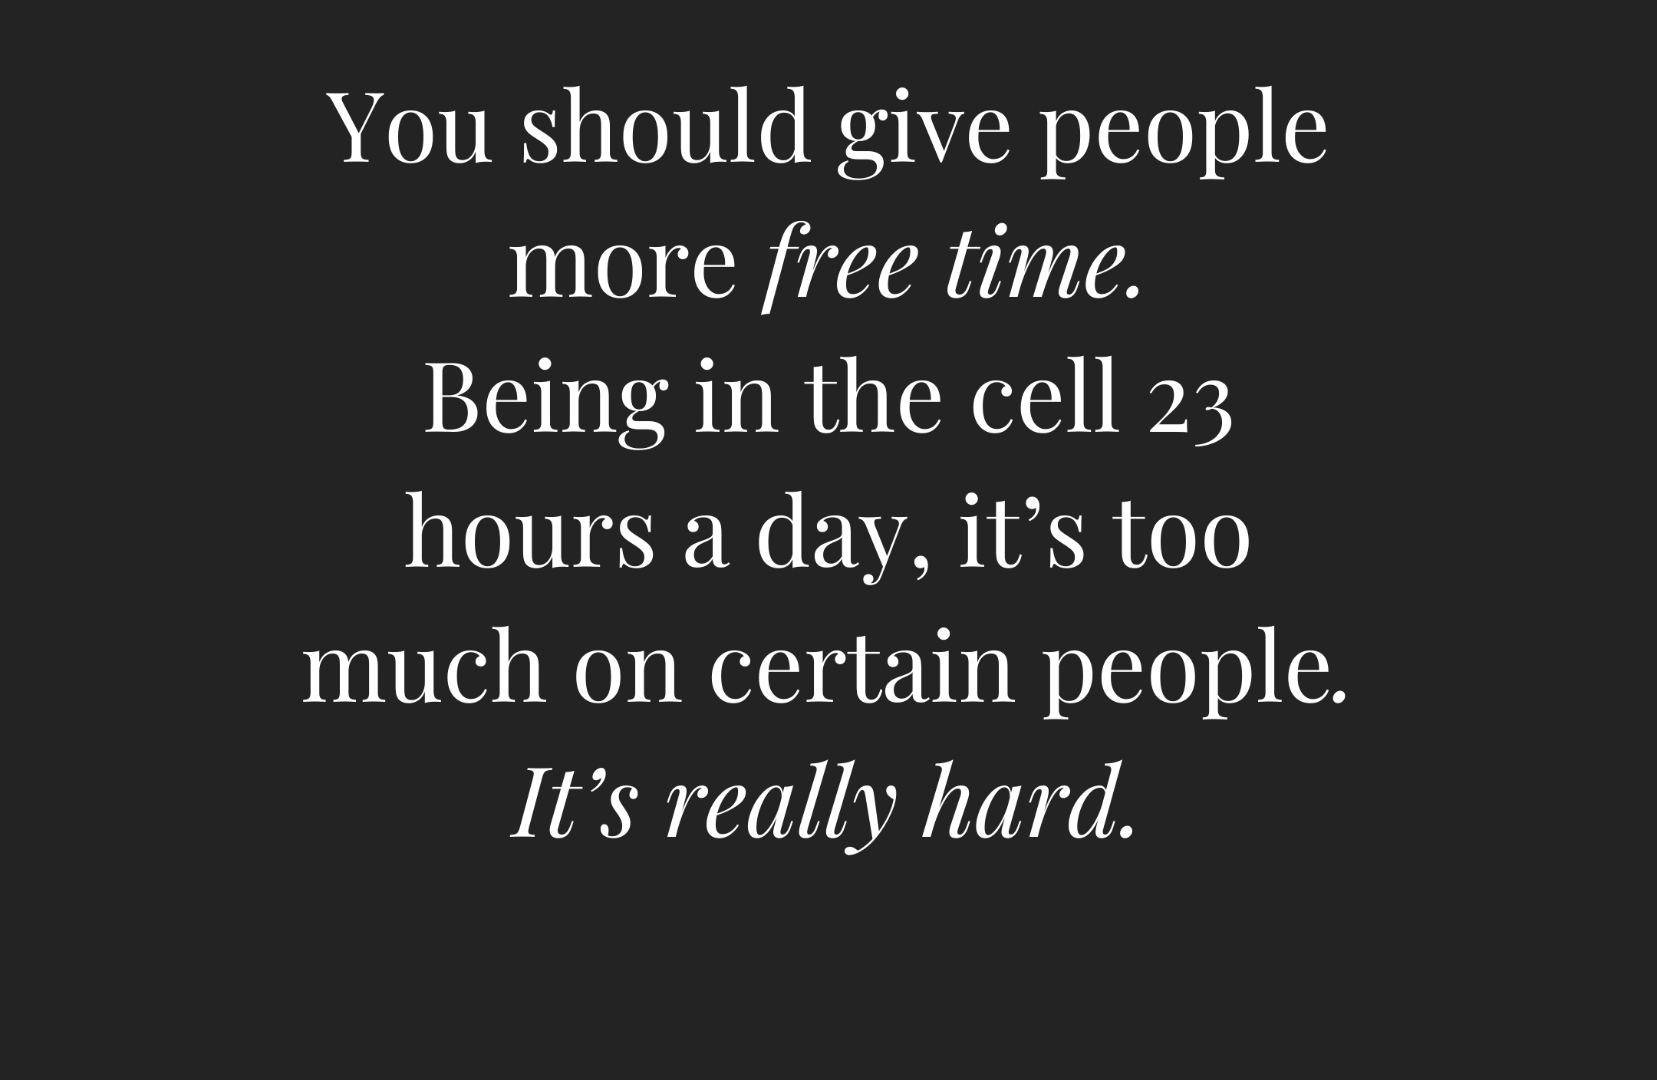
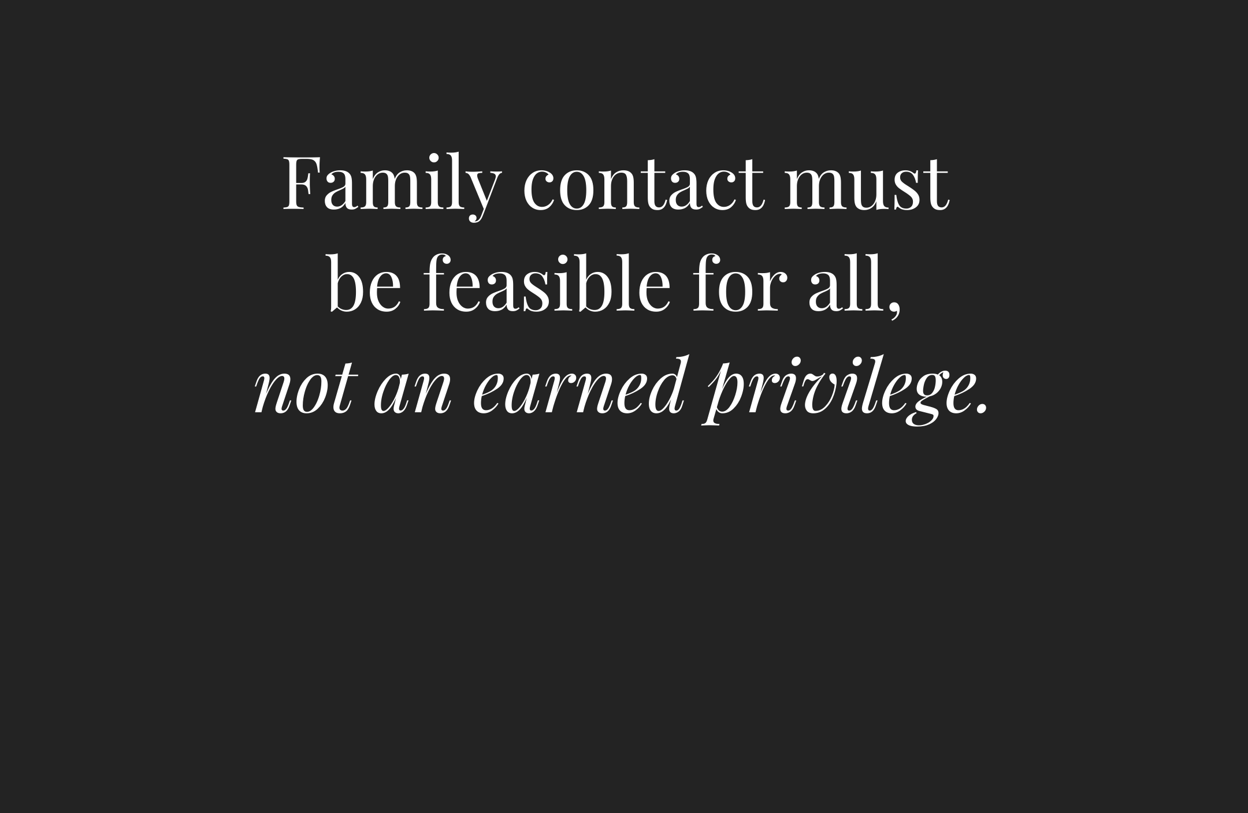
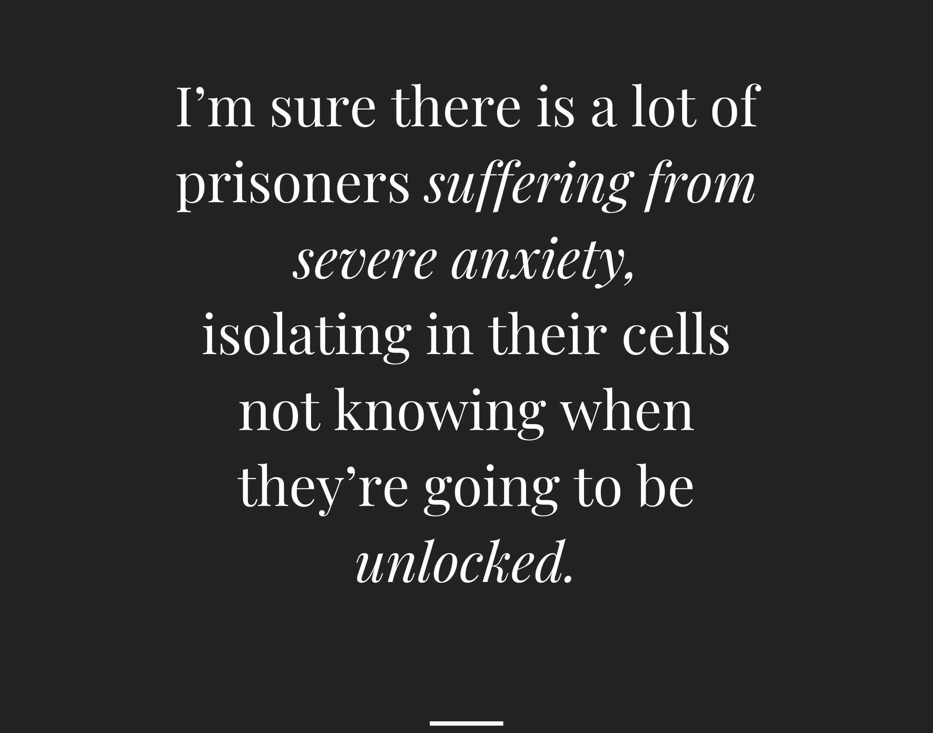
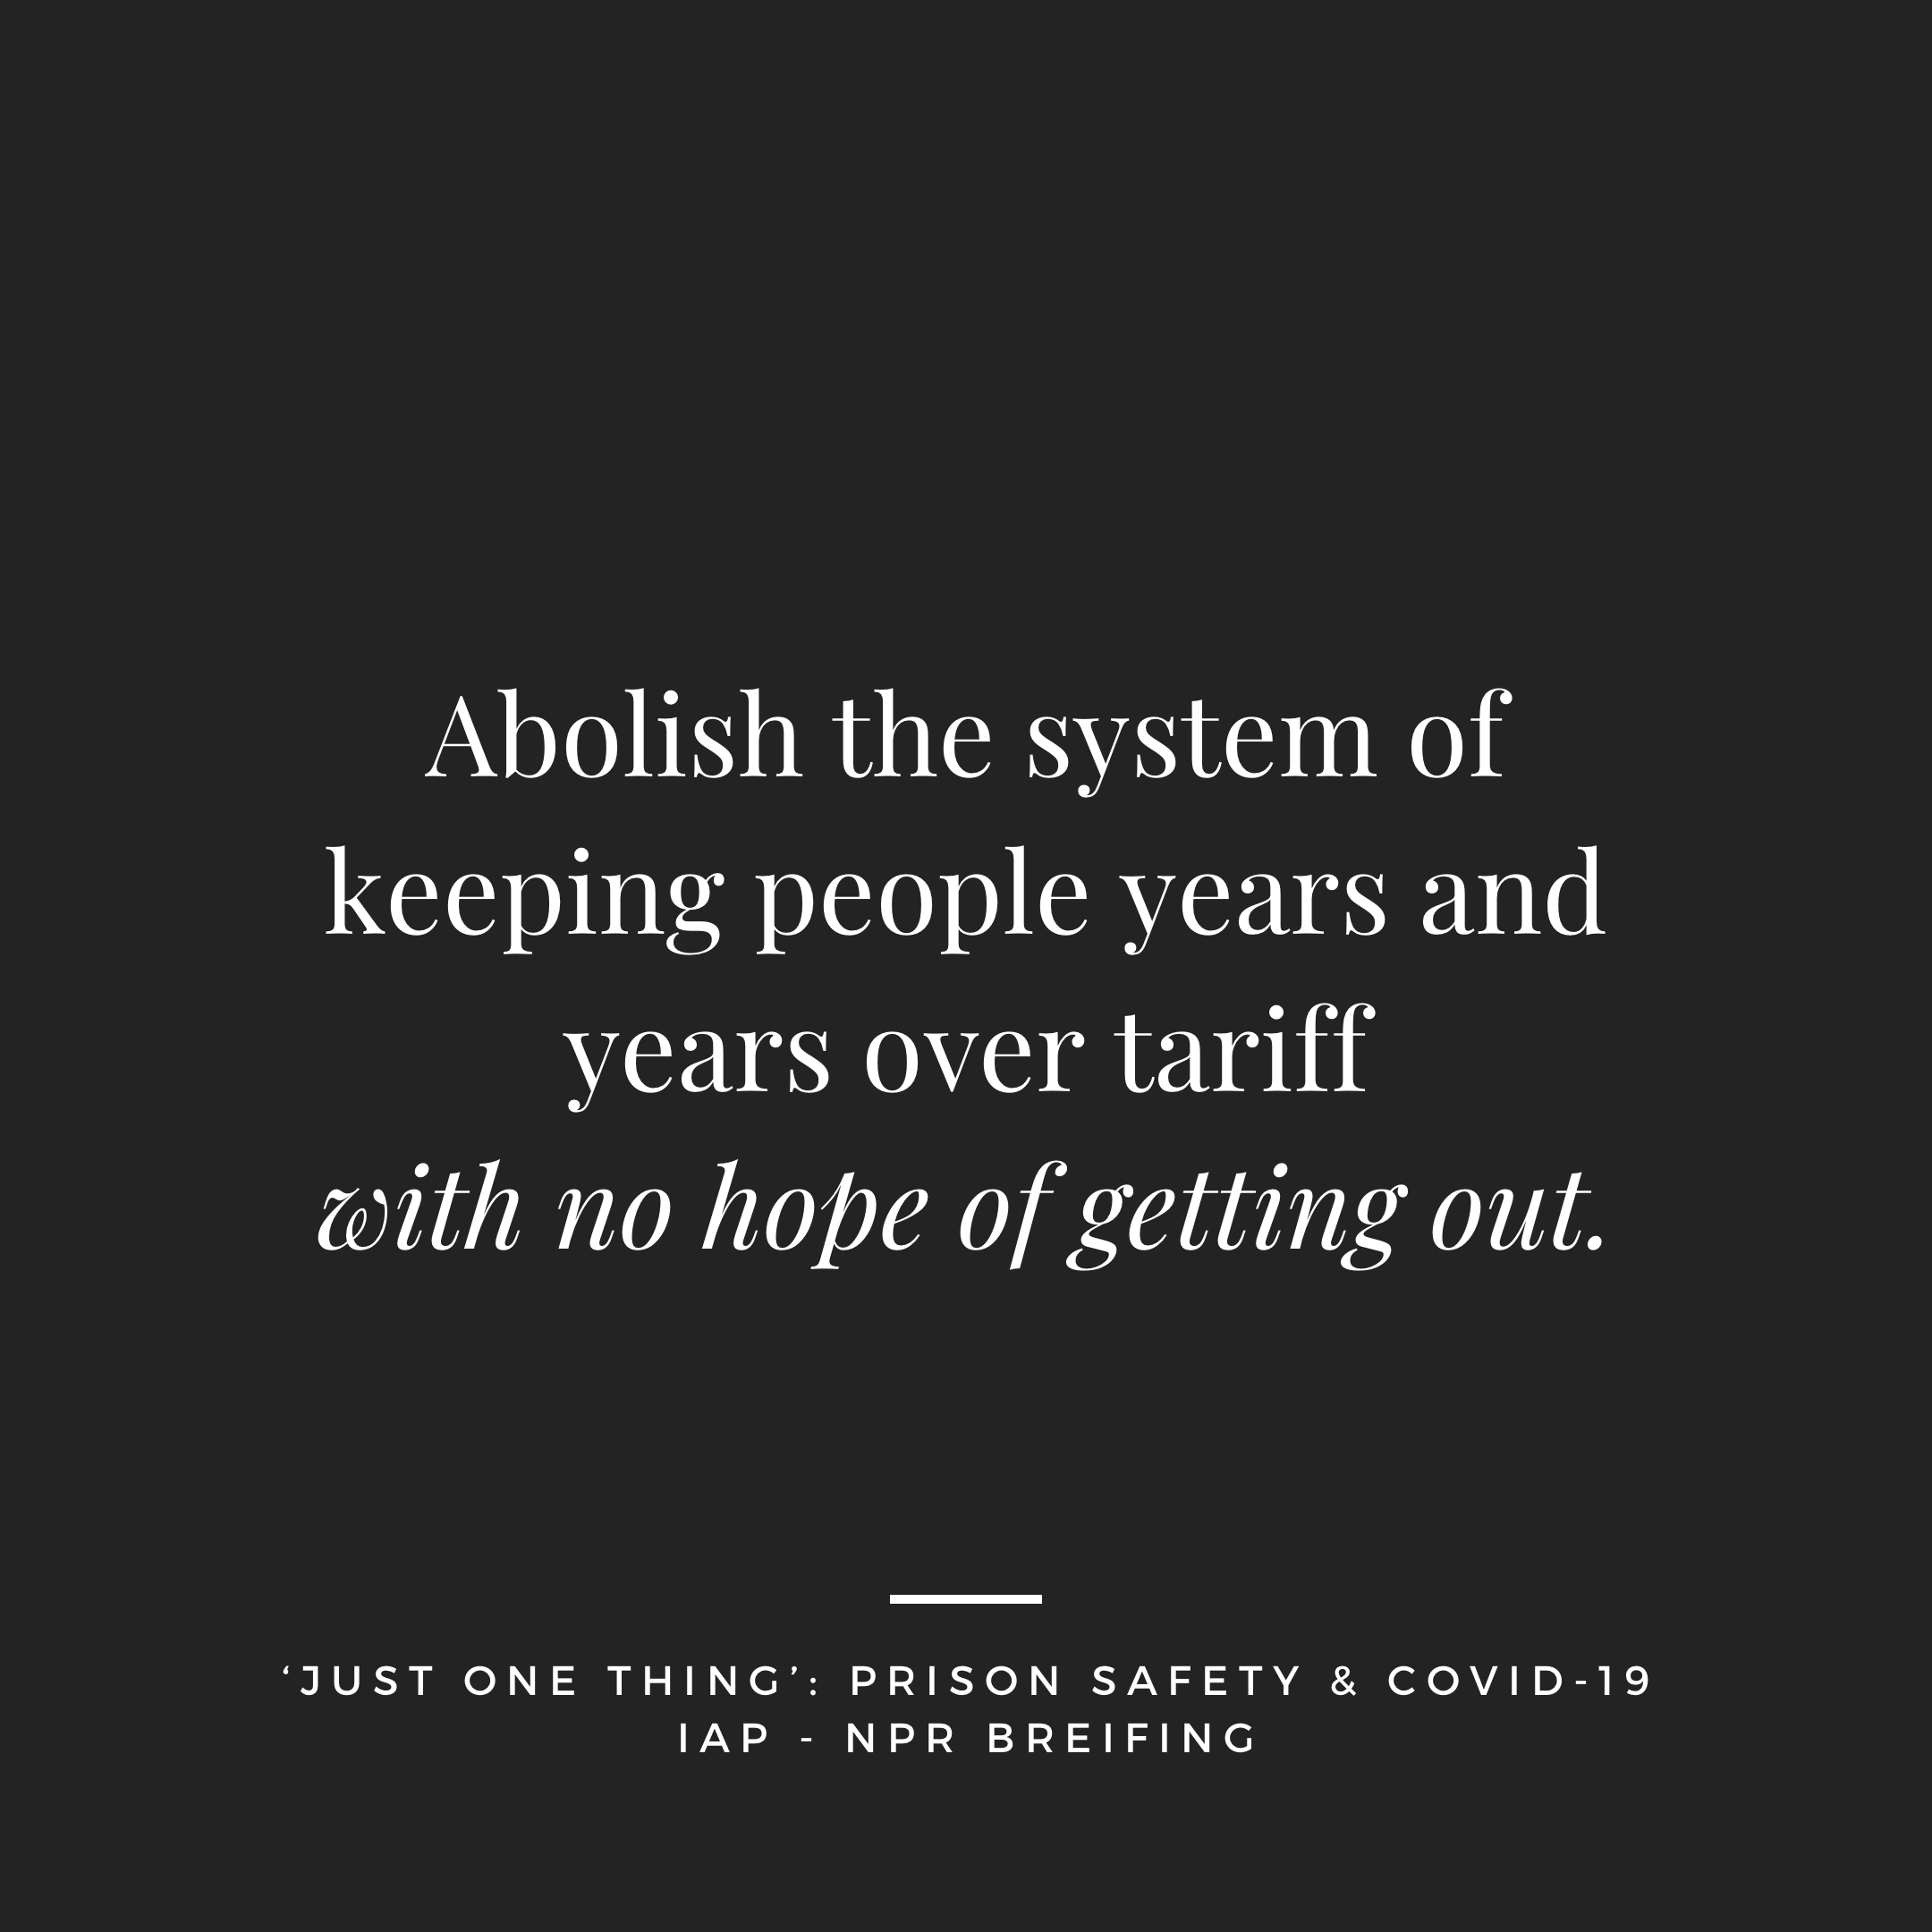

Slide 18
‘I think people in custody end up using substances cause they're just in an empty room. You come in here from nothing and you have nothing when you come in here, if you want people to change, you have to change…’

Slide 19
‘I would like the prison service to use this lockdown time to try some new initiatives regarding rehabilitation and education and mental health. Extreme times call for extreme actions, and the biggest shame in prisons is the waste of human resources.’

Slide 20
- Meaningful, productive and stimulating activity with form, purpose and reward improves mental wellbeing and reduces substance misuse and poor behaviour. - Prisoner safety is enhanced by considerate staff who listen, prioritise acts of kindness and are supported by their employer through resourcing, support and supervision. Staff and prisoners benefit from the opportunity to build positive professional relationships
‘JUST ONE THING’ RECOMMENDATIONS

Slide 21
- Contact with families has been a lifeline for prisoners. Steps must be taken to ensure systems such as video calls are working as intended across the estate. The feedback and ideas of those who use the technology developed through the pandemic should help shape the future of communications. - COVID-19 presents an unprecedented opportunity to innovate and improve. Prisons with hope and purpose and opportunities to take responsibility and help others keep people safe.
‘JUST ONE THING’ RECOMMENDATIONS

Slide 22
The reports can be found in our COVID-19 Information Hub on our website: www.iapondeathsincustody.org/covid-19 Keep Talking, Stay Safe www.iapondeathsincustody.org/latest/keep-talking-stay-safe Just One Thing www.iapondeathsincustody.org/latest/just-one-thing

Slide 23
Juliet Lyon Juliet.Lyon@justice.gov.uk
Thank you to the Koestler Trust for the
use of the images in this presentation.

Slide 24
The Ministerial Council on Deaths in Custody is made up of a Ministerial Board on Deaths in Custody, the Independent Advisory Panel on Deaths in Custody, and a Practitioner and Stakeholder Group (PSG). This group is drawn from inspectorate and investigative bodies, lawyers, third sector organisations, families, academics and practitioners from the custodial sectors. As a member of the group you can expect to receive regular communication with links to relevant news and publications from across the sectors; updates from the IAP website and invitations to stakeholder events. To be added to the list, please visit www.iapondeathsincustody.org/psg where you can fill in your information and give us an idea of your area of interest and/or expertise.
Notes:
The Panel would like to encourage practitioners from a range of organisations, particularly mental health settings, as well as families to join the group.

